Slide 1



General Validation Tool (GVT) Overview
GVT is part of the NIST HL7 V2 Standards Development and Testing platform. It utilizes all the artifacts developed in IGAMT and TCAMT, including validation services provided by the Testing Infrastructure and Framework, to allow users to develop conformance testing tools. GVT can be accessed at https://hl7v2.gvt.nist.gov/gvt . GVT documentation and guidance is found under the GVT tool Documentation tab.
IGAMT
TCAMT
Testing Infrastructure & Framework
GVT
NIST HL7 V2 Standards Development and Testing Platform

Slide 2

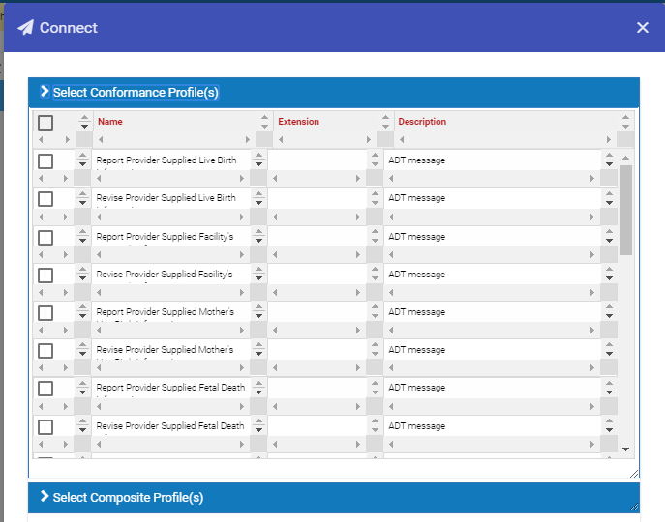
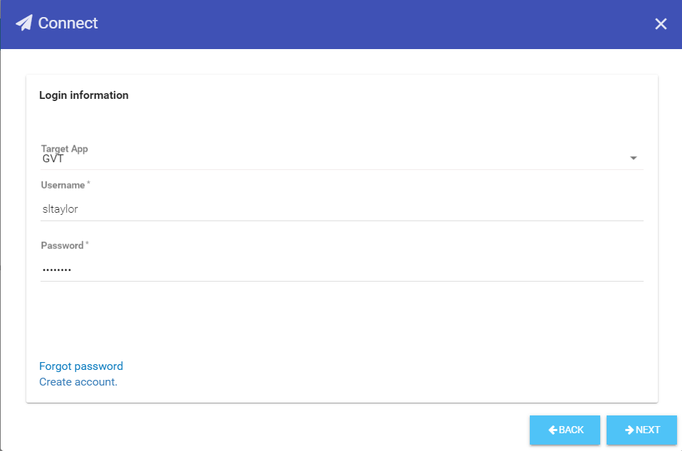
Connecting and Pushing Profiles to GVT from IGAMT
1
In IGAMT, select IG Documents from the main menu bar; open an IG document, select Connect from the IG Document menu bar.
2
From the Connect window, select desired profiles from the Select Conformance Profile(s) listing and/or the Select Composite Profile(s) listing.
4
Select GVT to connect to the GVT tool, enter the Username and Password for GVT, and click NEXT button.
3
Click on NEXT.

Slide 3
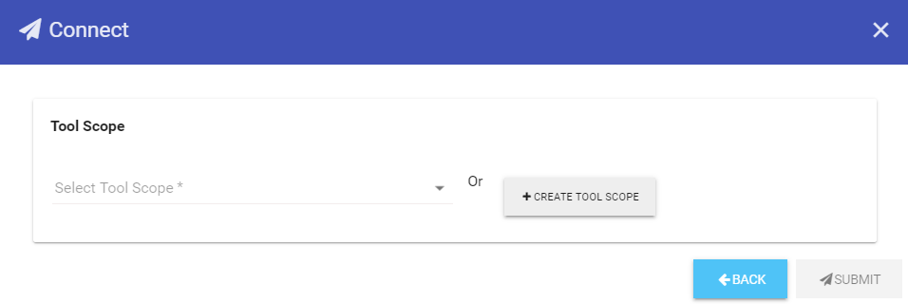
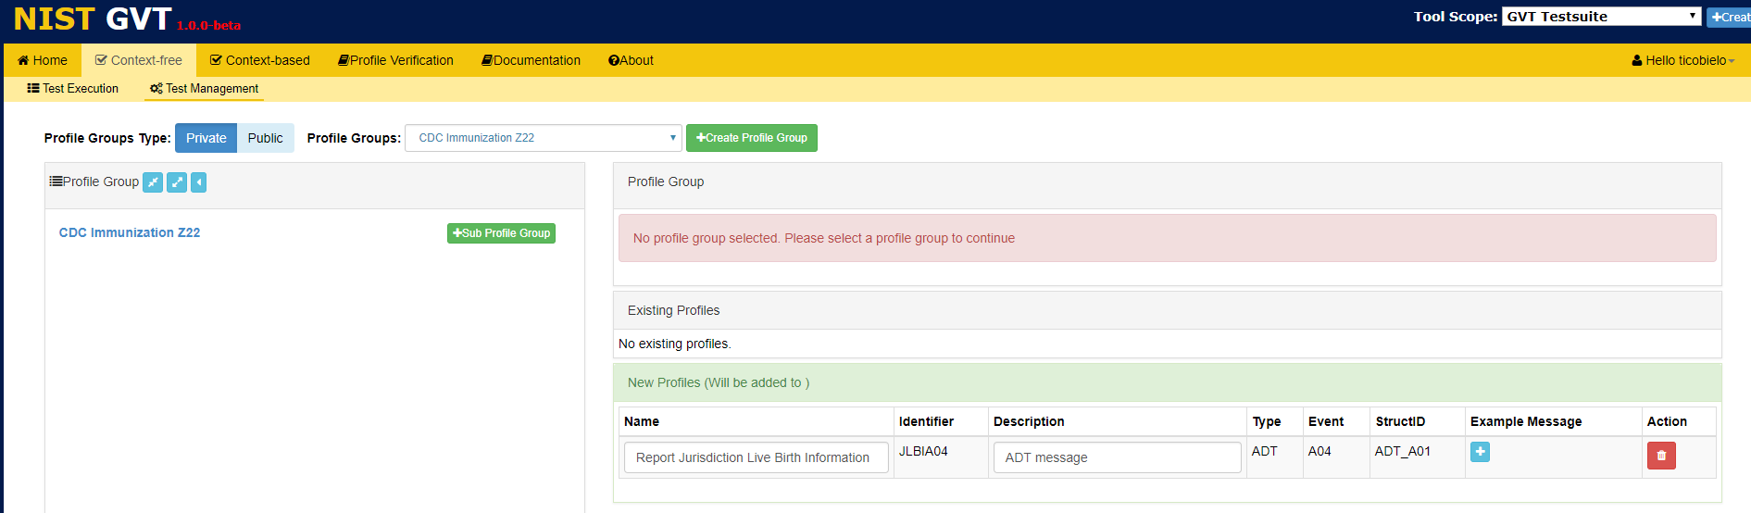
Connecting and Pushing Profiles to GVT from IGAMT
5
Click on the +CREATE TOOL SCOPE button OR click on “Select Tool Scope” and select an existing Tool Scope from the dropdown menu and SUBMIT.
6
In GVT Test Management, click on the Profile Group name to display the Profile Group information.

Slide 4
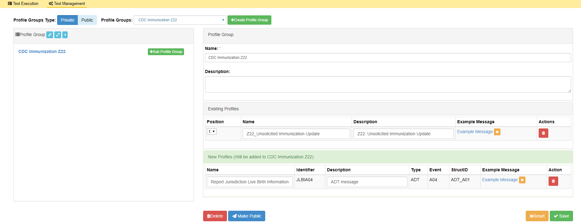
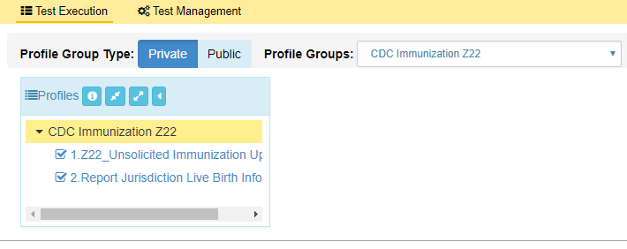
Connecting and Pushing Profiles to GVT from IGAMT
7
View Profile Group information.
8
Enter (type in or copy/paste) Example Message for the new Profile and click √Save.
Profile Group Type is Private by default; registered users with Publisher Privileges can click on Make Public to change to Public type.
9
View Profile Group and associated Profiles in the Profiles list panel in GVT Test Execution.

